Slide 1
Course: ECE249
Basic Electrical & Electronics Engineering
Unit-IV
Transistor (PNP & NPN)

Slide 2
Outline
Basics
Construction
Principal of operation
Important Terminologies, Configurations
Characteristics
Advantages, Applications

Slide 3
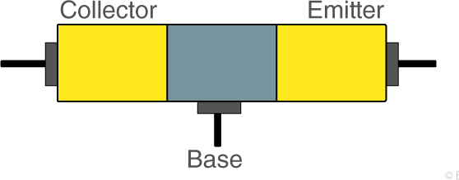
Basics
A transistor is a semiconductor device with three terminals, capable of amplification and switch.

Slide 4
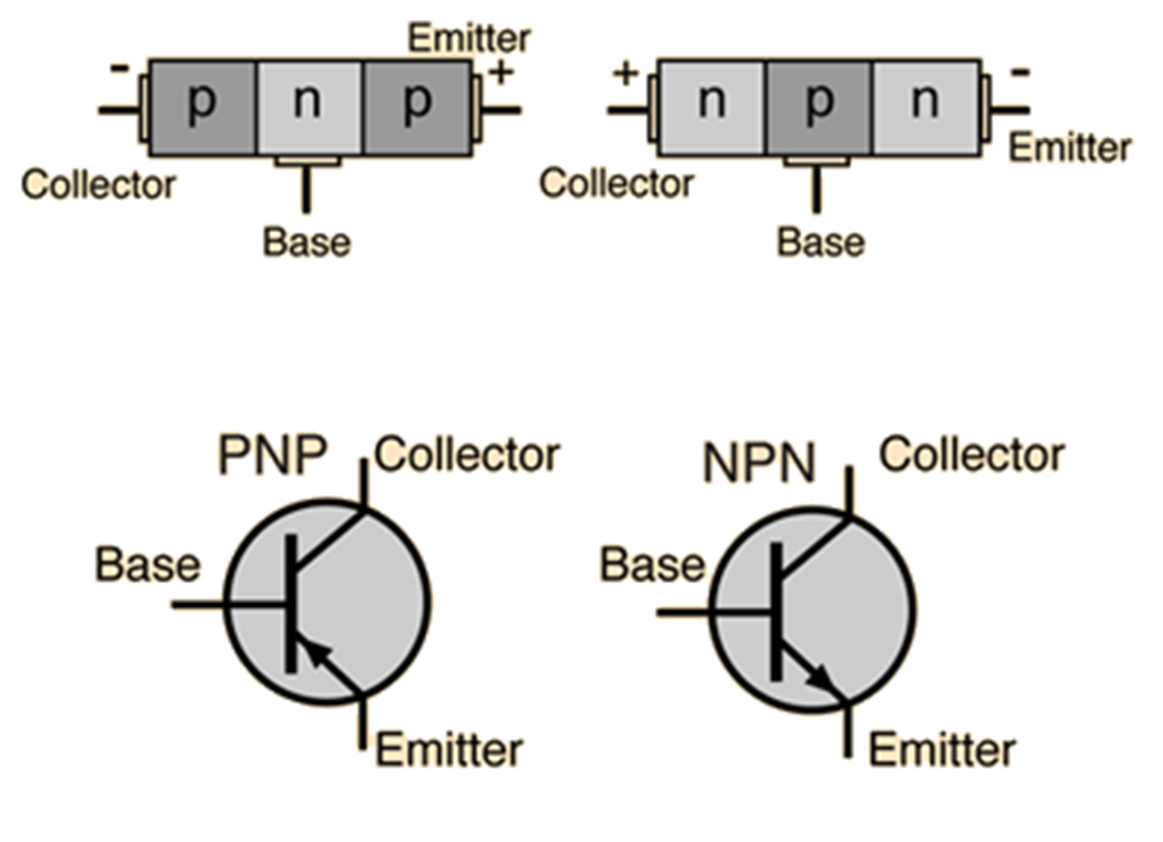
PNP & NPN Transistors & Symbols

Slide 5
Transistor Construction
Connecting TWO diodes back to back
TWO PN junctions
THREE terminals are drawn out of the construction
The way the P & N materials are arranged results in PNP or NPN transistor
PNP – N-type material between TWO P-type material
NPN – P type material between TWO N-type material

Slide 6
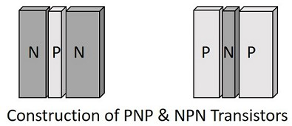
Cont…

Slide 7
Transistor Terminals
Emitter – This segment is on the left side of the transistor. It is moderately sized and heavily doped. The function of it is to supply a number of majority carriers i.e., either electrons or holes. (Emits electrons, also called as emitter) indicated with a letter symbol E.
Base – The middle segment/center of the transistor. It is thin and lightly doped. The main function of this is to pass the majority carriers from emitter to the collector. Indicated with a letter symbol B.

Slide 8
Cont…
Collector – This segment is on the right side of the transistor. It is larger than the Emitter & Base and is moderately doped. The name implies that its function is to collect the carriers. This is indicated by letter symbol C.

Slide 9
Cont…
The Arrow-Head indicates that it is an emitter.
Collector of the transistor has made large enough that, it dissipates greater power.
Due to specific function of the emitter and collector they are not interchangeable
Hence terminals are always kept properly while using it.
A notch is always present near emitter terminal.
Terminals can also be identified using multimeter.

Slide 10
Transistor Biasing
Transistor consists of (1) Emitter-Base Junction (2) Collector – Base Junction
Biasing is controlling the operation of the circuit by providing power supply.
W.K.T Forward Bias and Reverse Bias
Emitter-Base junction is always forward biased, as the emitter resistance is very small.
Collector-Base junction is always reverse biased, and the resistance offered is bit higher.

Slide 11
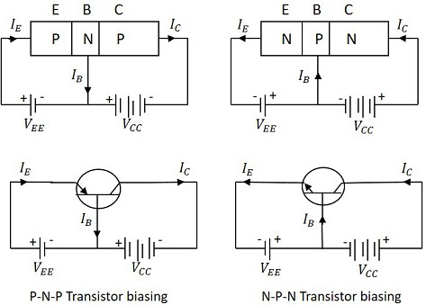

Slide 12
Cont…
Hence the name TRANSFER-RESISTOR (TRANSISTOR)
Small Forward Bias & High Reverse Bias
The direction of current indicated in the circuits above, also called as the Conventional Current, is the movement of hole current which is opposite to the electron current.
Current directions in the emitter can be observed.

Slide 13
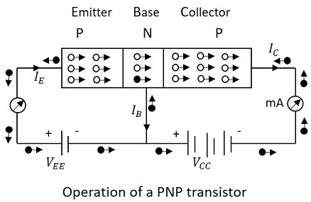
Principle of Operation - PNP

Slide 14
Cont…
Emitter-Base Junction Forward Bias, Collector-Base Junction is Reverse Bias
V_{EE} provides a positive voltage to the emitter – repels the holes in the p-type material – those holes cross the emitter-base junction to reach the base region.
Very few holes recombine with electrons in the N-type base region.
This provides a low base current called I_{B.}
The remaining holes cross the collector-base junction, to constitute collector current I_{C}, which is the hole current.

Slide 15
Cont…
As a hole reaches the collector terminal, an electron from the battery negative terminal fills the space in the collector.
This flow slowly increases and the electron minority current flows through the emitter, where each electron entering the positive terminal of V_{EE}, is replaced by a hole by moving towards the emitter junction. This constitutes emitter current I_{E}.

Slide 16
Cont…
In summary,
The conduction in a PNP transistor takes place through holes.
The collector current is slightly less than the emitter current.
The increase or decrease in the emitter current affects the collector current.

Slide 17
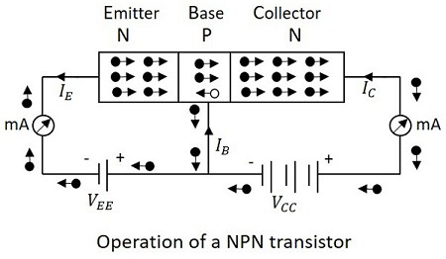
Principle of Operation – NPN

Slide 18
Cont…
Emitter-Base Junction forward Biased, Collector-Base junction Reverse Biased
The voltage V_{EE} provides a negative potential at the emitter which repels the electrons in the N-type material and these electrons cross the emitter-base junction, to reach the base region.
There a very low percent of electrons recombine with free holes of P-region.
This provides very low current which constitutes the base current I_{B}. The remaining holes cross the collector-base junction, to constitute the collector current I_{C}.

Slide 19
Cont…
As an electron reaches out of the collector terminal, and enters the positive terminal of the battery, an electron from the negative terminal of the battery V_{EE} enters the emitter region.
This flow slowly increases and the electron current flows through the transistor.
The conduction in a NPN transistor takes place through electrons.
The collector current is higher than the emitter current.
The increase or decrease in the emitter current affects the collector current.

Slide 20
Transistor Configuration
Based on the connections, transistor configuration is classified as
  Common Emitter Configuration
  Common Base Configuration
  Common Collector Configuration (Emitter Follower)

Slide 21
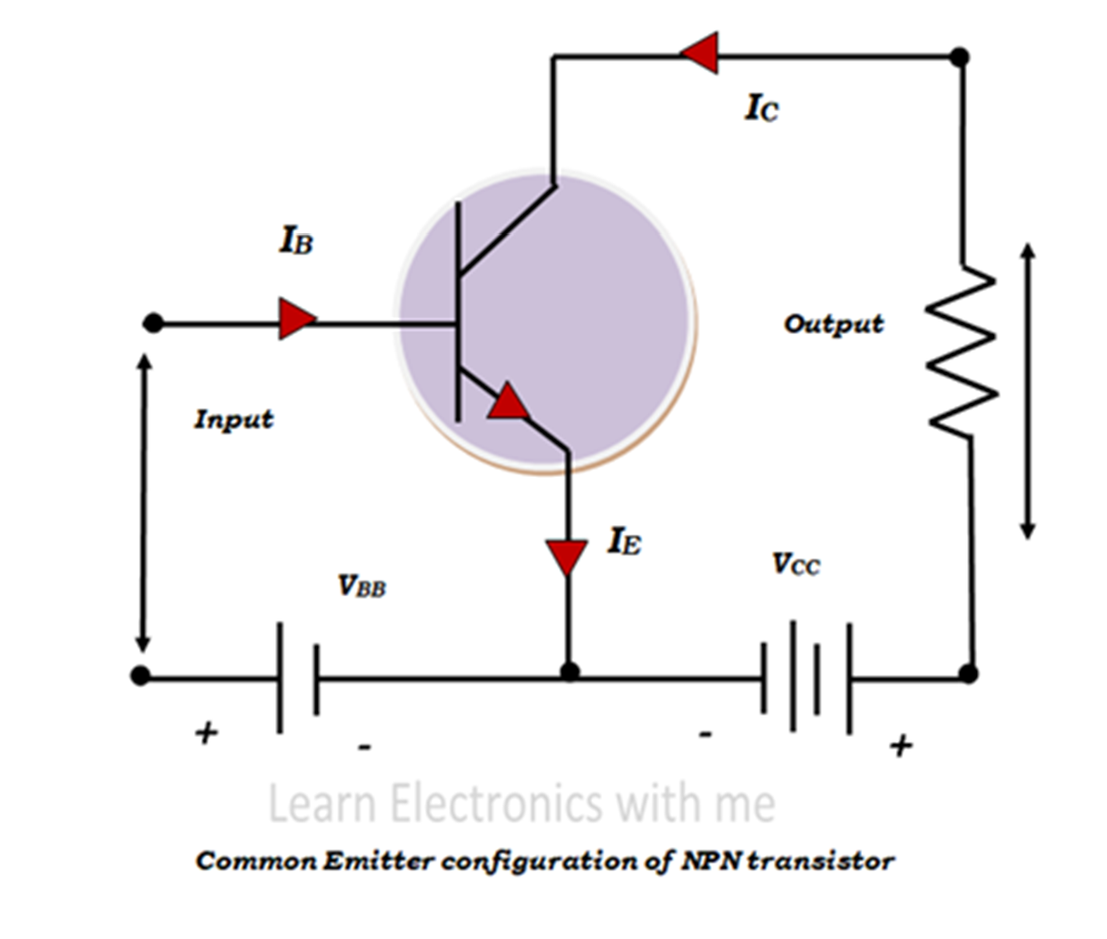
- NPN
Common Emitter

Slide 22
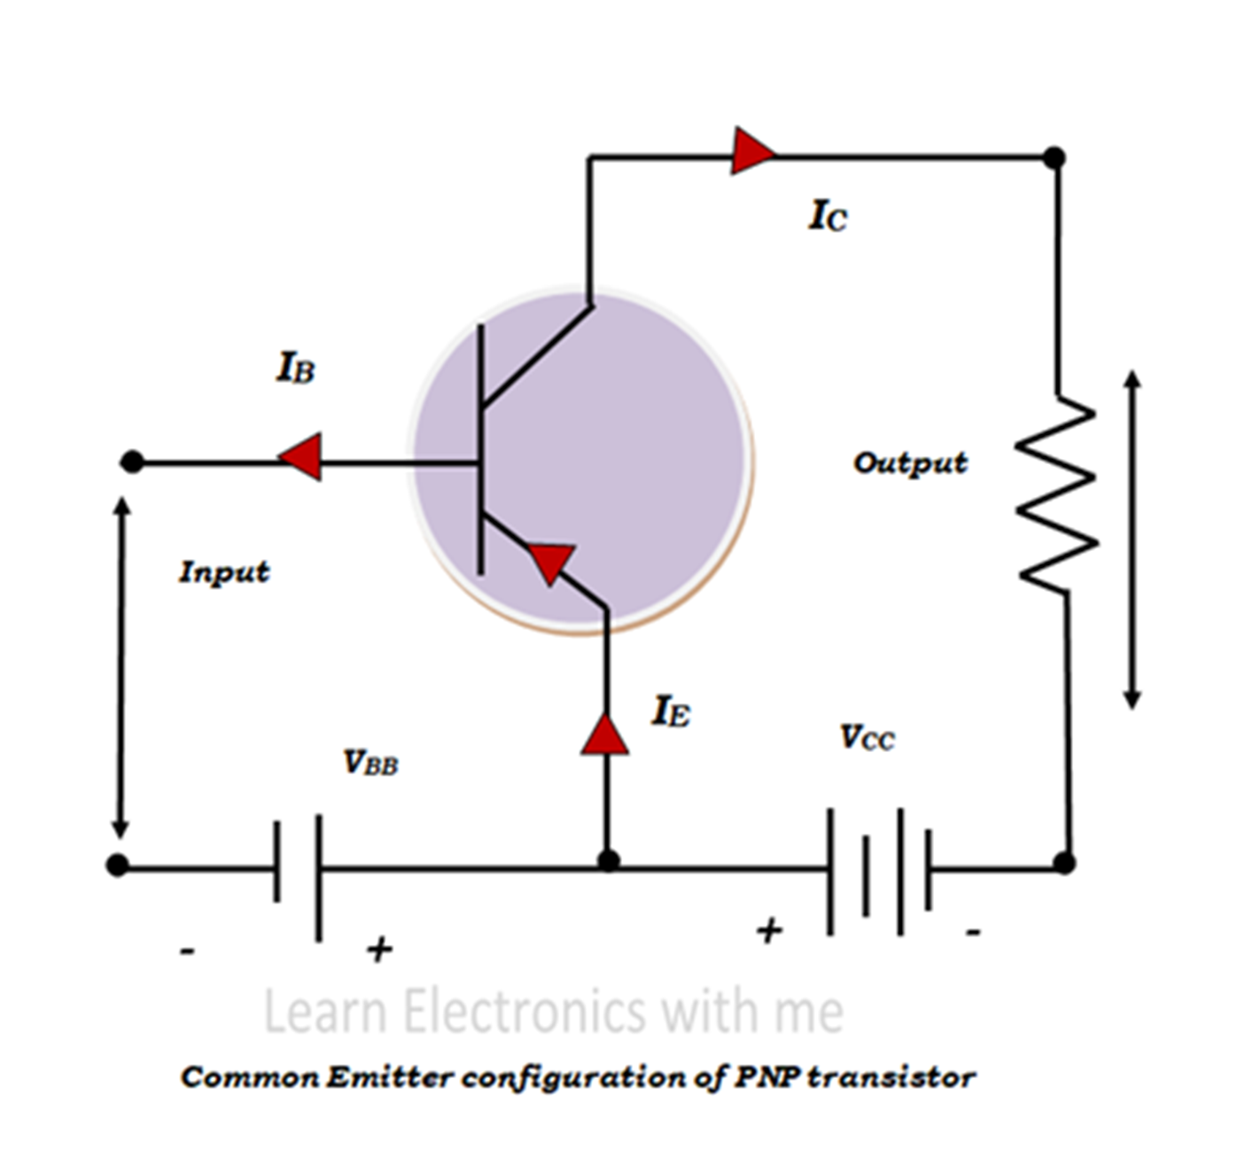
Cont… for PNP

Slide 23
Common Base
Two terminals are needed for input and two terminals for output. Transistors have three terminals, so one terminal have to be taken as common terminal for both input and output.
In Common Emitter configuration, emitter terminal is taken as common for both input and output.
So input is given between base and the emitter terminals and output is taken between collector and emitter terminals.
This is the most commonly used configuration.

Slide 24
Cont…
Input voltage V_{BE} is applied between base and emitter terminals and output voltage V_{CE} is applied across emitter and collector.
The output current I_{C} is taken across the emitter and collector terminals.
The input side is forward biased and the output side is reverse biased.

Slide 25
Cont…
Emitter base region acts like forward biased diode and so the depletion region is very small.
Emitter collector region acts like reverse biased diode and the depletion region is large.
The input current I_{B} is measured in µA because the base region is very lightly doped.
The input and output impedance are moderate in common emitter configuration and thus the current and voltage gain is moderate and the power gain is high.
So this configuration is widely used for amplification.

Slide 26
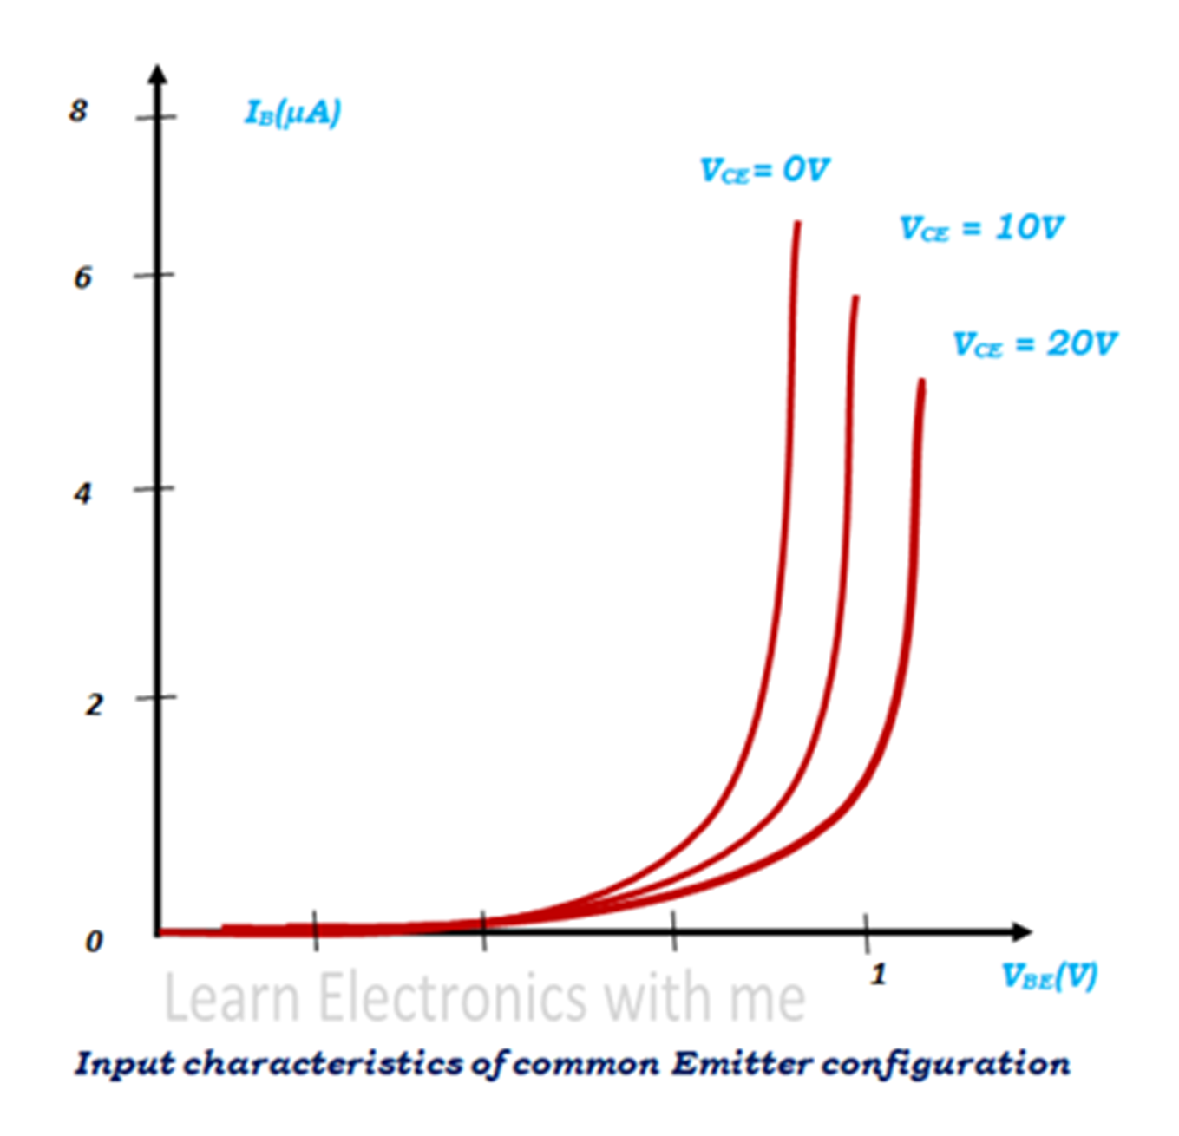
Input Characteristics – CE config

Slide 27
Cont…
Input characteristics are the relationship between the input current and the input voltage keeping output voltage constant.
Here the input current is the base current I_{B}, input voltage is base emitter voltage V_{BE} and the output voltage is collector emitter voltage V_{CE}.
First the output voltage V_{CE} is kept at zero and the input voltage V_{BE} is gradually increased and the input current I_{B} is noted. Then again the output voltage V_{CE} is increased like 10V, 20V and kept constant and by increasing the input voltage V_{BE}, the input current I_{B} is noted.

Slide 28
Cont…
From the results it is observed that when the input voltage V_{BE} is increased initially there is no current produced, further when it is increased the input current I_{B} increases steeply. When the output voltage V_{CE} is further increased the curve shifts right side.

Slide 29
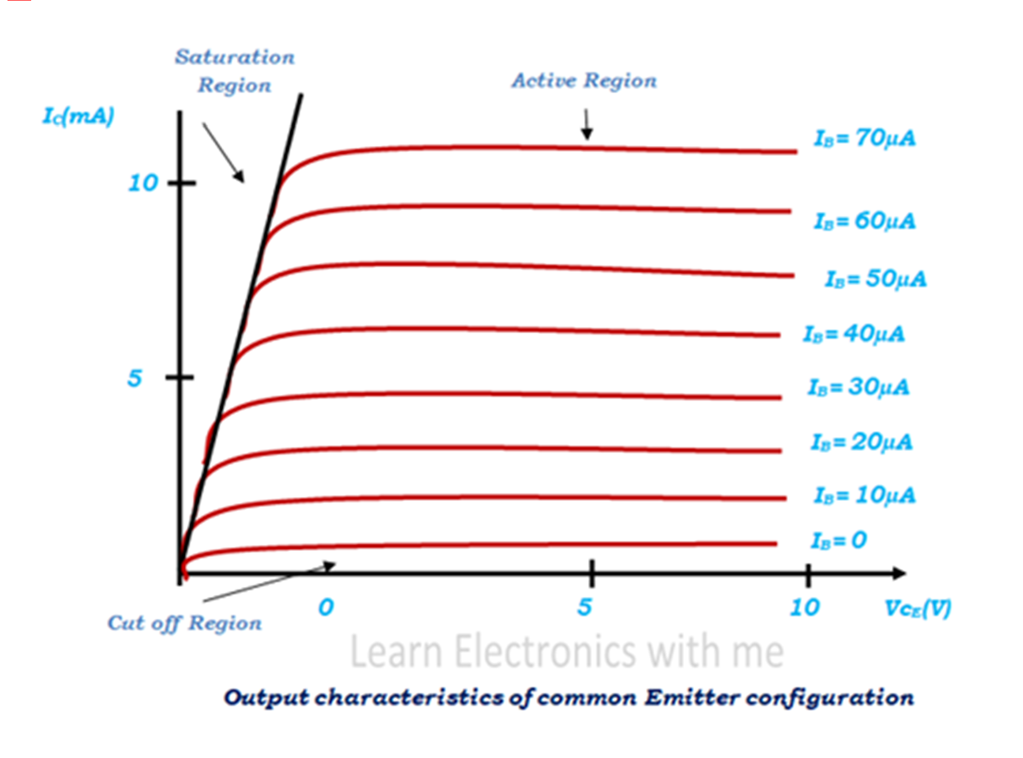
Output Characteristics – CE Config

Slide 30
Cont…
Output characteristics is the relationship between the output current and the output voltage keeping input current constant.
Here the values of output current I_{C} and the output voltage V_{CE} is noted keeping input current I_{B} constant.
In active region when the output voltage is increased there is very slight change in the output Current.
The curve looks almost flat in the active region. Cut off region is the region where the input current is below zero. When both the junctions are forward biased, it is in saturation region.

Slide 31
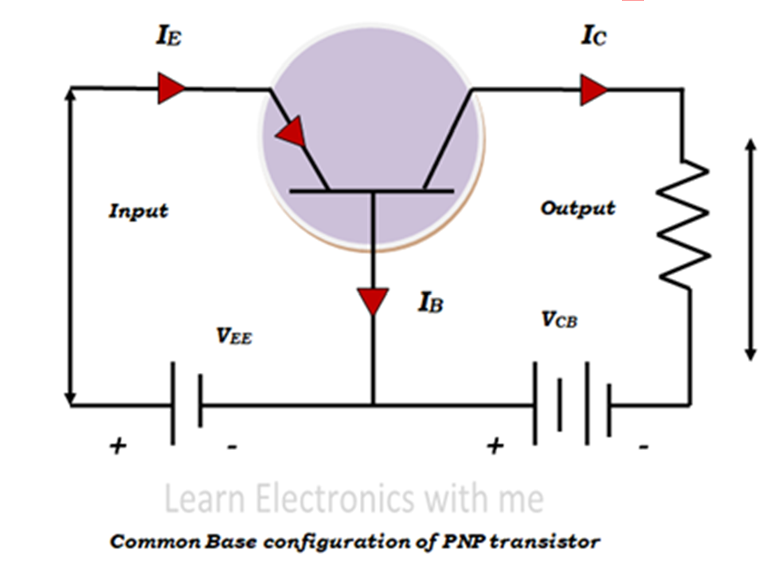
Common Base Config. - PNP

Slide 32
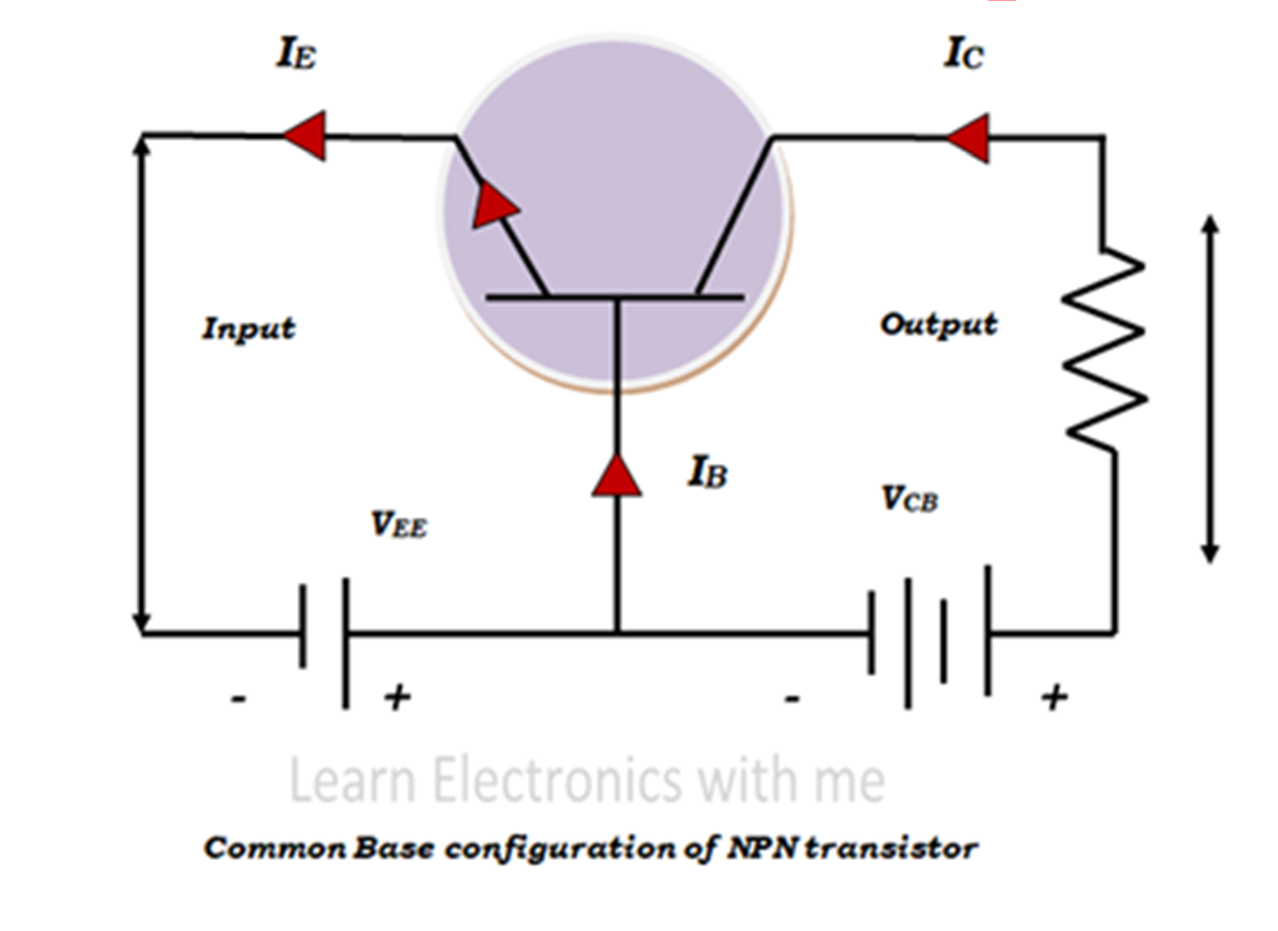
Common Base Config - NPN

Slide 33
Input, Output Characteristics of CB
config.
https://www.learnelectronicswithme.com and learn from it.
Left it as a Work to Students
Future discussion in the class session

Slide 34
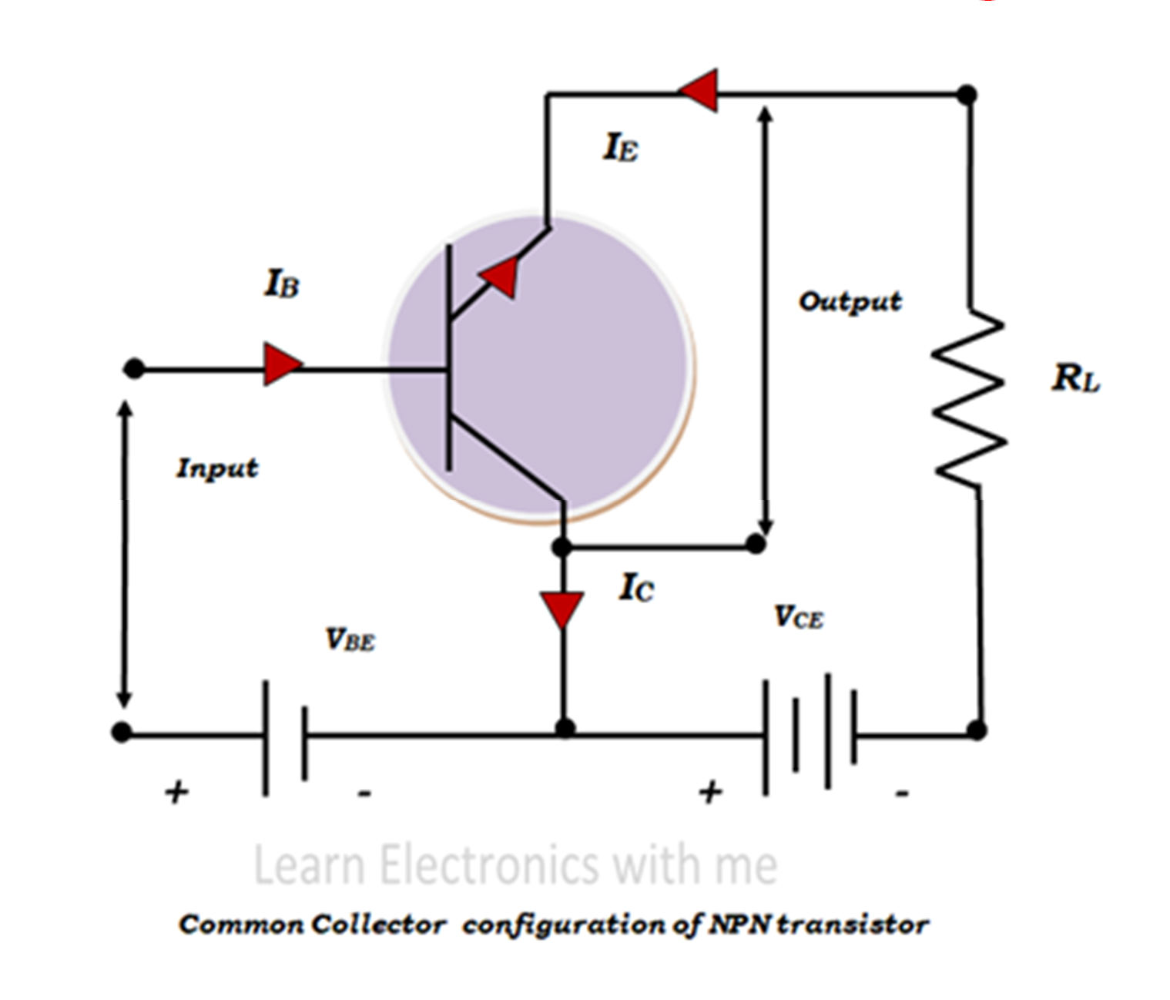
Common Collector Config – CC, NPN

Slide 35
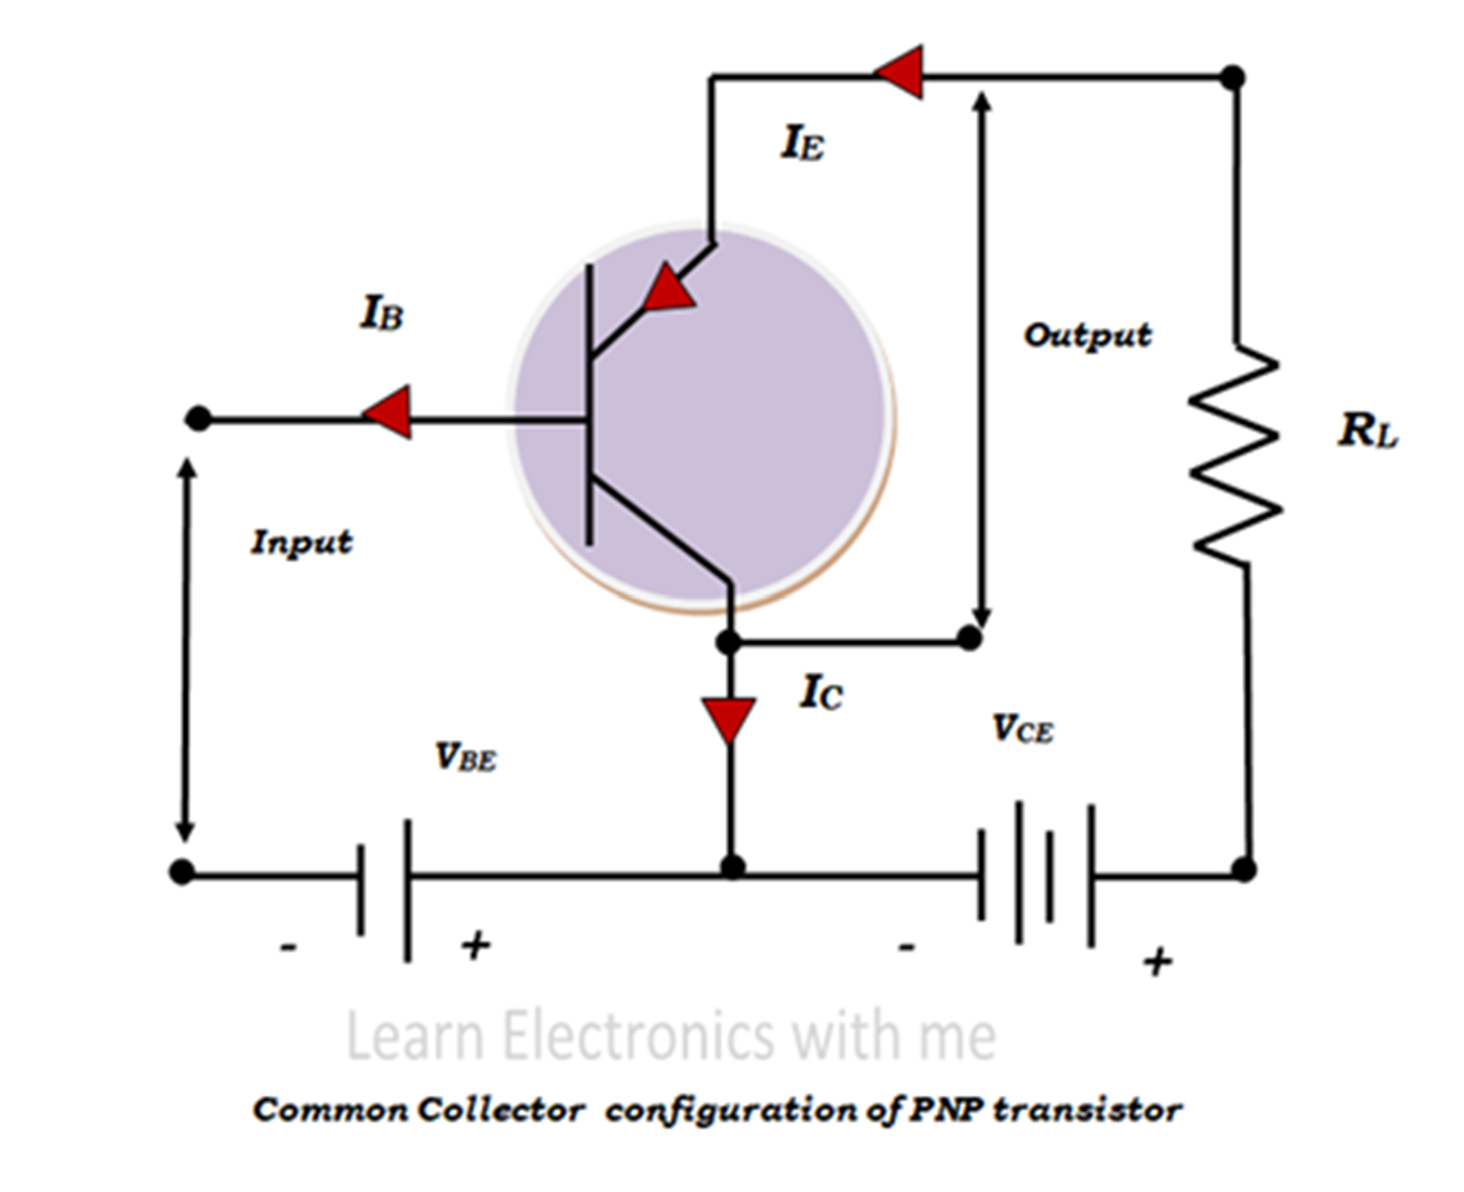
Common Collector Config – CC, PNP

Slide 36
Input, Output Characteristics of CC
config.
https://www.learnelectronicswithme.com and learn from it.
Left it as a Home Work
What is the alternate name for Common Collector configuration?
Future discussion in the class session

Slide 37
Advantages of Transistor
High voltage gain.
Lower supply voltage is sufficient.
Most suitable for low power applications.
Smaller and lighter in weight.
Mechanically stronger than vacuum tubes.
No external heating required like vacuum tubes.
Very suitable to integrate with resistors and diodes to produce ICs.

Slide 38
Applications of Transistor
As an Amplifier
As a Switch
Used in Integrated Circuits (ICs)

